Slide 1

Patient Monitoring System
Nikolaos Karapoulatidis
Electronic Engineering, Hochschule Hamm-Lippstadt, Marker Allee 76-78, 59063 Hamm

Slide 2
Table of contents

Slide 3
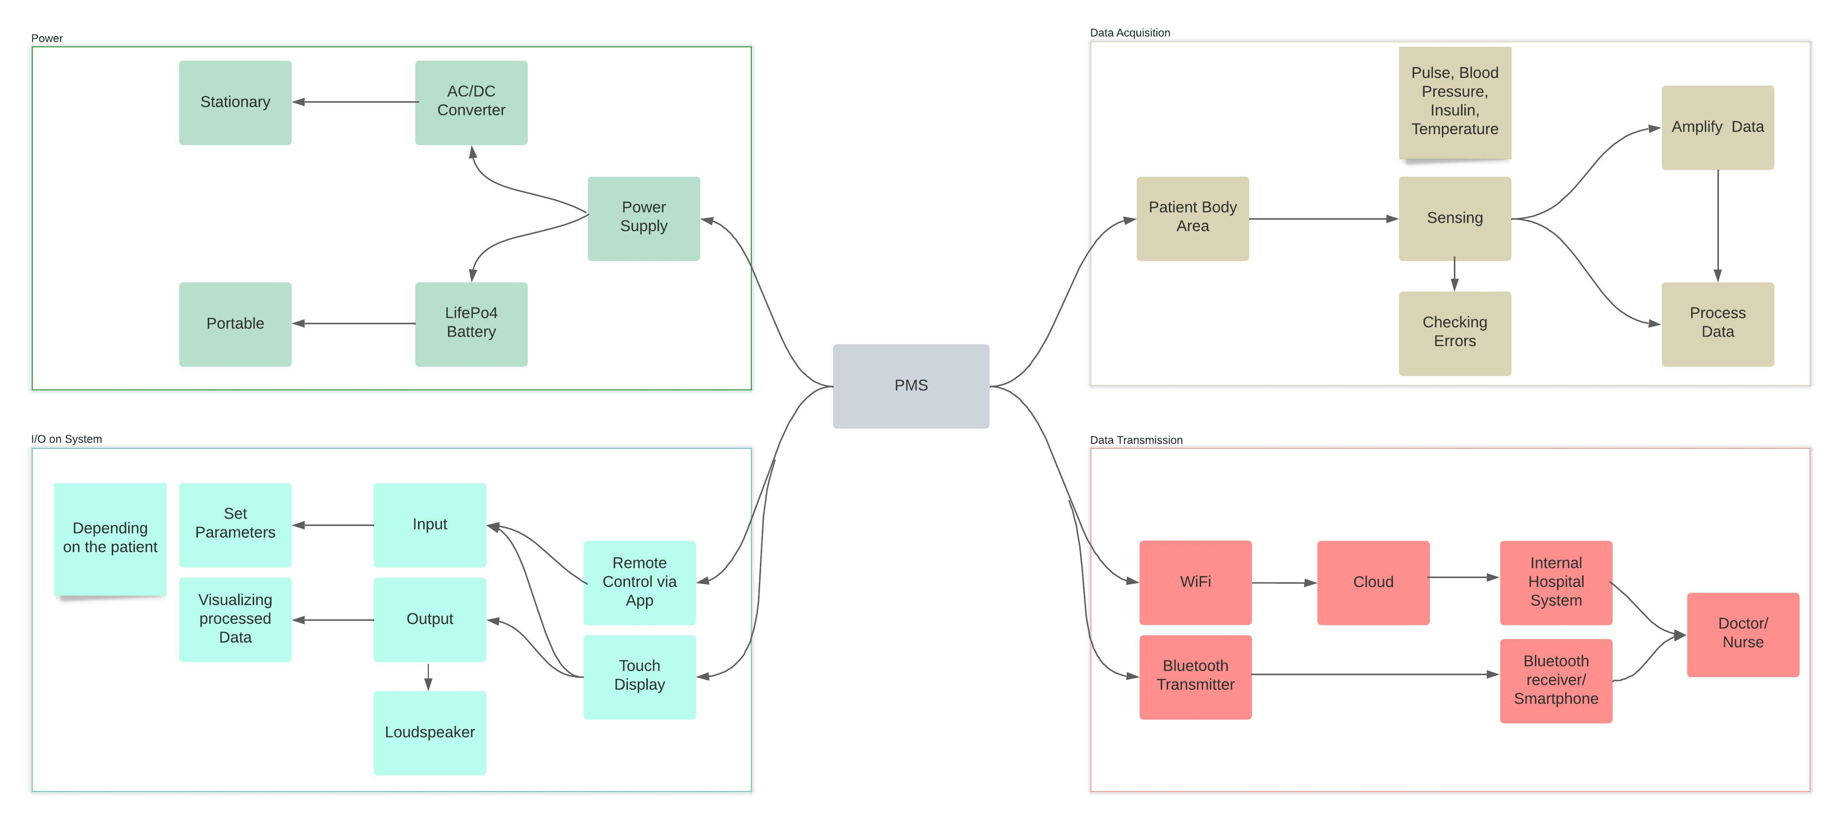
Concept

